Slide 1
MODULE 13-14: Project Closure
Dittas Formoso

Slide 2
LEARNING OUTCOMES
What is project closure
Know why project closure is important
What are the steps to properly close the project

Slide 3
What is project closure?
The closing phase of project management is the final phase of the project lifecycle. This is the stage where all deliverables are finalized and formally transferred, and all documentation is signed off, approved, and archived.
The project closure process ensures that:
All work has been completed according to the project plan and scope.
All project management processes have been executed.
You have received final sign-off and approval from all parties.

Slide 4
WHY IS PROJECT CLOSURE IMPORTANT
Confirmation of Objectives Being Met
Sense of Closure
Improving Future Engagements
Capturing the Knowledge
Tying up Loose Ends
Rewarding the Team

Slide 5
1) Confirmation of Objectives Being Met
“Did we accomplish what we set out to do?”
Part of the closure process is to obtain project or UAT (User Acceptance Testing) sign-off from your client to confirm that you and your team have met the project objectives and met the agreed-upon requirements.

Slide 6
2) Sense of Closure
Confirming that objectives have been met to the client’s satisfaction gives the client and the project team a sense of accomplishment and closure.
It gives the client a sense that you and your company are serious about helping them meet their objectives, and you will stay accountable for what was promised.

Slide 7
3) Improving Future Engagements
During the project closure process, it is essential that a lessons learned meeting happen with the client and another with the internal team.
Clients will respect you more for asking the hard questions and soliciting honest feedback.
These questions should be asked as part of project closure:
What would we do differently next time around?
How did we work together as a team?
How can communication be improved?
How can we improve our project methodologies?
Did we under or overestimate certain pieces?
What were the major accomplishments?

Slide 8
4) Capturing the knowledge
As part of the lessons learned sessions, the team should identify project assets (documents or code), that can be re-used in future engagements.
Set up a knowledge base where all the project documents can be accessed by the internal team and the client in the future.
You don’t want to lose the key assets and re-usable components from each project. This is how you continually make your engagements more efficient over time!

Slide 9
5) Tying up loose ends
There are a lot of administrative tasks that must happen at the end of a project to make sure the project is appropriately closed from a back-office perspective.
Tasks like:
sending the final status report,
asking for the final payment,
approving all time sheets and r
e-assigning resources, should all be part of the closure process to make sure they are executed in a timely fashion

Slide 10
6) Rewarding the team
Recognition of a job well done is just as important as sharing constructive feedback.
Making a company-wide announcement to share the successful completion of the project and thanking the team is extremely important.
It’s also important to celebrate with the client. It allows you to connect with your client in a social setting (which is highly recommended even while the project is on-going) and to thank the key stakeholders for their support and contribution throughout the engagement.

Slide 11
7 Steps to Closing a Project
Formally transfer all deliverables
Confirm project completion
Review all contracts and documentation
Release resources
Conduct a post-mortem
Archive documentation
Celebrate

Slide 12
1) Formally transfer all deliverables
The first step to closing out your project is to finalize and transfer the project deliverables to the client.
Go through your project plan to identify all deliverables and make sure they have been fully completed and handed off.

Slide 13
2) Confirm project completion
To confirm the project’s completion, you will need to obtain approvals for the project deliverables (i.e., all stakeholders must agree that you delivered on all parts of the project plan) with official sign-offs from the project stakeholders.

Slide 14
3) Review all contracts and documentation
Once you have completed the project hand-off and received approvals from the clients, you can begin closing out your contracts.
Review all the project documentation to ensure all parties have been paid for the work and there are no outstanding invoices.

Slide 15
4) Release Resources
Formally release resources from the project, including suppliers, contractors, team members, and any other partners.
Notify them of the end of the project, confirm any final payments or obligations, and officially release them so they are free to work on other projects.

Slide 16
5) Conduct a post mortem
A post-mortem or project review is one of the most valuable steps of the project closure process. This is a time to review the successes, failures, and challenges of the project and identify opportunities for improvement going forward.
Consider these questions:
Did you stay on budget?
Did the team members involved manage their time wisely?
Were there issues with the quality or compromises along the way?

Slide 17
Conduct a post mortem
Conduct a survey or hold a meeting with the project management team to get feedback on how the project went.
Consider the following questions:
What went well?
What were the challenges or failures?
How well did the team communicate?
Did the team follow the outlined processes and plan?
Was the client satisfied with the results?
What would you change or improve for future projects?

Slide 18
6) Archive Documentation
Once you’ve completed your project post-mortem, you can finalize all documentation (contracts, project plans, scope outline, costs, schedule, etc.) and index them in the company archives for later reference.

Slide 19
7) Celebrate
The end of a project is a big accomplishment and represents the culmination of many hours of hard work and dedication from a team of contributors.
An end-of-project party is a great way to acknowledge your team’s hard work and increase morale. Plus, a happy team is more likely to work with you in the future so you can build on your past successes and become a more effective unit going forward.

Slide 20
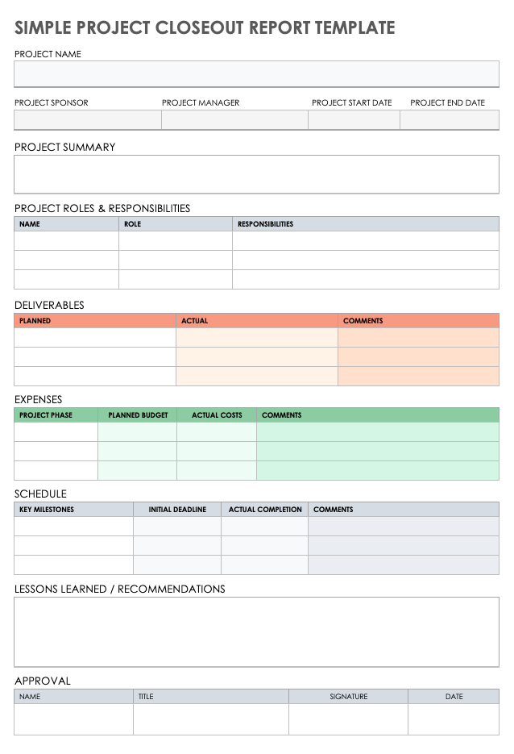

Slide 21
GROUP WORK
Prepare the project closure report of your project based on the template.
Create using MS Word

